Slide 1

Epi Info™ 7
Software for Public Health
EIS Summer Course
José Aponte
Public Health Advisor
Adding Intelligence to Data Entry Forms
July 2015
Center for Surveillance, Epidemiology, and Laboratory Services
Division of Health Informatics and Surveillance

Slide 2
Learning Objectives
After completing this section, the participant will be able to:
  Familiarize with the Check Code workspace
  Understand the basics of Check Code
  Identify different Check Code commands
  Create basic Check Code logic

Slide 3



Quality during Capture
Common data quality concerns:
  Transposition errors – letters, numbers or other symbols are shifted from the correct position (e.g., 12 vs 21).
  Translation errors – incorrect interpretation (e.g., rain vs rein).
  Missing data – answer to the question (i.e., content) is not available.
  Non-sensical data – content does not make sense given the question.
  Inconsistent data – content conflicts with the answer to another question.
  Duplicate records – multiple records for the same individual.

Slide 4
What do we mean by adding intelligence?
Add certain logic to the form using Check Code
  The term comes from the need to “check” user input to ensure it is valid.
Used to implement data entry “rules” – invalid input can be rejected.
You don’t need to be a programmer!
Notes:
When entering data into our forms, wouldn’t it be nice if we could build in some level of intelligence? For example, what if we could automatically calculate a patient’s age based on the date the survey was filled out and the patient’s date of birth? Perhaps we’d rather create a skip pattern such that the cursor will skip all questions on pregnancy (that is, not giving the data entry person the ability to fill those fields out) if “Male” is selected for gender.
Epi Info 7 contains a very powerful programming capability called Check Code that allows form designers to do exactly these types of things.
The term “Check Code” originated from the desire to “check” the user’s input for accuracy and correctness.
Many other types of programming can be conducted as well. We can hide certain fields based upon one or more conditions, we can check to see if the survey date is greater than the date of birth and erase the user’s invalid input, we can execute other Windows applications, we can display messages to the user, and we can carry out mathematic operations.

Slide 5
What can Check Code do?
Check Code can be used to…
  Automatically calculate values, such as figuring out a patient’s age
  Implement skip patterns
  Prompt the user
  Automatically populate fields
  Hide fields from data entry workers

Slide 6
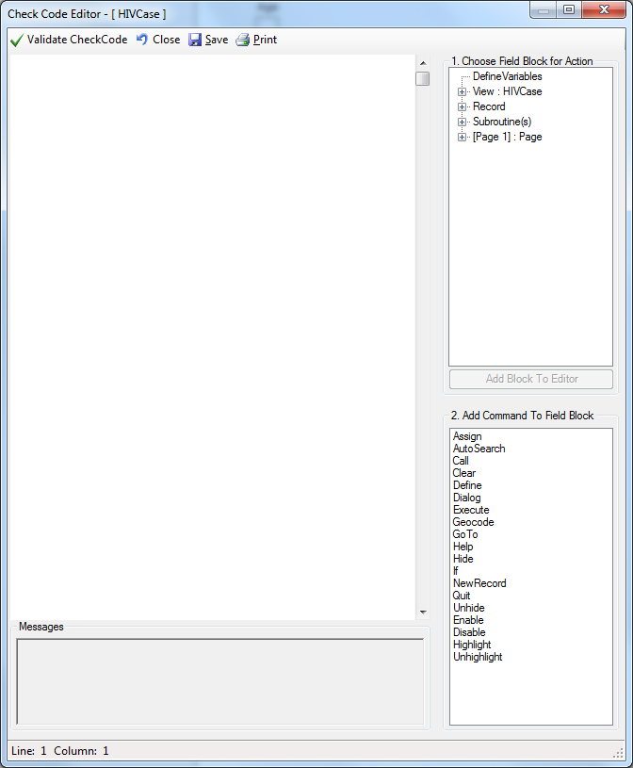
Check Code is Easy
Check Code is created using the Check Code Editor.
The editor lets you implement the desired logic without requiring any programming skills.
Anyone can do it!

Slide 7
Creating a Check Code
Which field on your form do you want the rule to happen?
When do you want the rule to happen?
      BEFORE
      AFTER
      CLICK
What command do you want to be executed?

Slide 8
BEFORE, AFTER and CLICK sections
Anything in the “BEFORE” section is run as soon as the cursor enters that field.
Anything in the “AFTER” section is run as soon as the cursor leaves that field.
Anything in the “CLICK” section is run as soon as the user clicks on the control (checkbox, command button, drop down list).

Slide 9
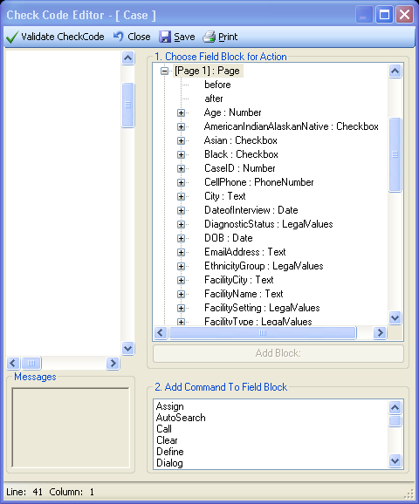
Step 1: Identify the relevant field
Open Check Code Editor.
Determine which field you want the “action” to take place.
  E.g. after a certain field is entered
Locate and select the appropriate field in the Check Code Editor .

Slide 10
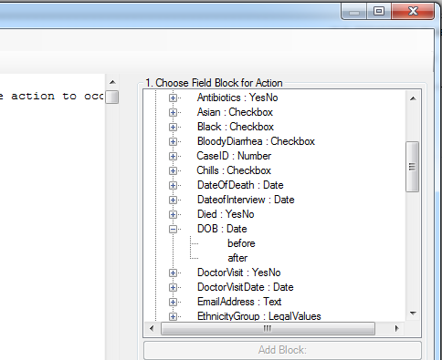
Step 2: Select the timing
Expand the field and select whether you want the “action” to occur before or after the field.
Double click on the action. If the block already exist:
  position the cursor under the last item entered in that block.

Slide 11
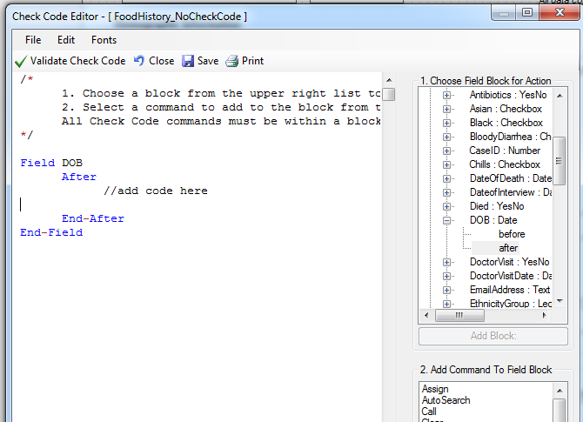
Cursor’s position when block is created
The cursor will move under:
  “//add code here”
You may need to manually reposition the cursor.

Slide 12
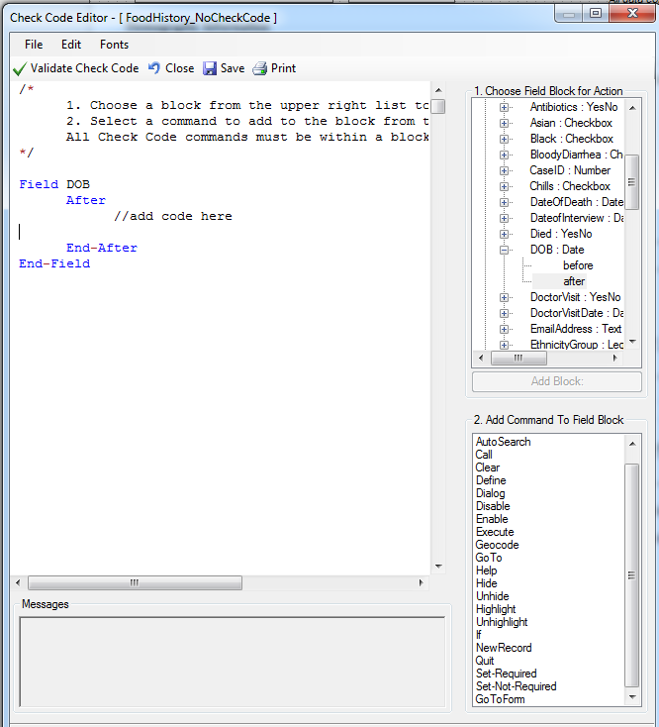
Step 3: What do you want it to do?
Multiple commands
can be executed.
Notes:
Now what do you want it to do

Slide 13
Common Check Code Commands
IF-THEN-ELSE: Allows different actions to occur for the same block depending on a condition. For example, if the patient is male, hide all questions on pregnancy.
GOTO: Forces the cursor to move to another field or page. GOTO is used to implement skip patterns.
HIDE / UNHIDE: Disallows/allows data to be entered into a field.
ENABLE / DISABLE: Enable and disables fields. Disabled fields cannot accept user input and are no longer part of the tab order.

Slide 14
Common Check Code Commands
ASSIGN: Used to pass/calculate a value to a field.
DIALOG: Used to display pop-up messages to the user.
CLEAR: Used to erase the value of a field.
HIGHLIGHT/UNHIGHLIGHT: Highlights a field in bright yellow/Removes any field highlighting that may have been applied.

Slide 15
Combining Commands
Example
  IF the user enters an invalid date…
  Use a DIALOG to warn the user about their error
  CLEAR the invalid date
  Return to the same field GOTO until proper value is entered
It would look like:
  IF DiagnosisDate < OnsetDate THEN
  DIALOG “Please verify Diagnosis date“
  CLEAR DiagnosisDate
  GOTO DiagnosisDate
  END-IF

Slide 16
Functions and Operators
Functions and operators are used to assist you in creating useful check code.
For example: You want to automatically calculate a patient’s age. You are collecting date of birth and onset date.
Use the YEARS() function to calculate the difference in years between two date fields.
Use the ASSIGN command to assign the value to a field.

Slide 17
Example of the YEARS function
It would look like:
  ASSIGN Age = YEARS(DateOfBirth, OnsetDate)
The values in the parenthesis are also known as the function’s parameters.

Slide 18
Assign Proper Check Code Syntax
Using the proper check code syntax is important based on the field type:
Assign the ‘Age’ field (numeric field type) the value 24
  ASSIGN Age = 24
Assign the ‘Ill’ field (Yes/No field type) the value No
  ASSIGN Ill = (-)
Assign the ‘AteChicken’ field (checkbox field type) the value Yes
  ASSIGN AteChicken = (+)

Slide 19
Assign Proper Check Code Syntax
Assign the ‘DateOfInterview’ field (Date field type) the value 5/5/2012
  ASSIGN DateOfInterview = 5/5/2012
Assign the ‘CaseStatus’ field (Legal Values field type) the value “Confirmed”
  ASSIGN CaseStatus = "Confirmed“
Assign the ‘Test Result’ field (Comment Legal field type) the value of “Positive” (coded as P-Positive, N-Negative)
  ASSIGN TestResult = “P"

Slide 20
INSTRUCTOR-LED DEMONSTRATION
EColi Project

Slide 21
Questions?
For more information please contact Centers for Disease Control and Prevention
1600 Clifton Road NE, Atlanta, GA 30333
Telephone: 1-800-CDC-INFO (232-4636)/TTY: 1-888-232-6348
Visit: www.cdc.gov | Contact CDC at: 1-800-CDC-INFO or www.cdc.gov/info
The findings and conclusions in this report are those of the authors and do not necessarily represent the official position of the Centers for Disease Control and Prevention.
Center for Surveillance, Epidemiology, and Laboratory Services
Division of Health Informatics and Surveillance

